Slide 1
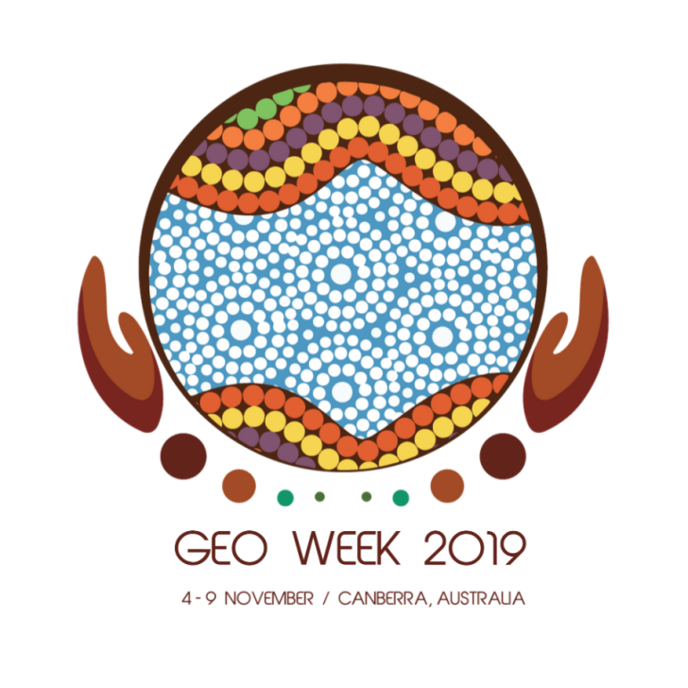
Delivering on GEO:
Achievements since the Mexico City Ministerial Summit
Paloma Merodio, National Institute of Statistics and Geography, Mexico
Stuart Minchin, Environmental Geoscience Division of Geoscience, Australia

Slide 2
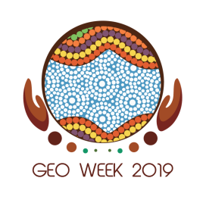
Building on the success of the Mexico City Ministerial Summit
Add text here
Notes:
Four years ago, the Group on Earth Observations met in Mexico City. Many of you in this room were there.
2015 was a year of momentous changes and agreements, for both GEO and the world at large. For GEO, it meant the consolidation of its many strengths and accomplishments, at the Mexico City Ministerial Summit in November 2015.

Slide 3
The world has realized the enormous potential the EO community had to contribute to essential processes.
Notes:
The Mexico City Ministerial Summit was also the first instance where the GEO community convened outside its headquarters and projected itself onto the world. That initial, and propitious leap has continued with increasing success with the GEO Plenaries in great cities all over the world, and now, with our 2019 Ministerial Summit in Australia, in the beautiful city of Canberra.
The world has realized the enormous potential the EO community had to contribute to essential processes in areas such as climate change, desertification and land degradation, biodiversity, disaster risk reduction, sustainable urban development, forest, ocean and agricultural monitoring and food security, all encompassed within the broader Agenda 2030 for Sustainable Development.

Slide 4
Today the Mexican Geospatial Data Cube is a reality involving great efforts in capacity building and technological infrastructure.
Notes:
Particularly in Mexico, we have received great guidance from the Earth Observations community, in our efforts to monitor the territory for our national priorities and the achievement of global commitments.
Back in 2018, our themed geospatial datasets were obtained, in fact, from satellite imagery. However, the processes involved only visual inspection, which prevented us from fulfilling the ever-growing demand for more timely and detailed products.
Only after deeply understanding that action was needed, today the Mexican Geospatial Data Cube is a reality involving great efforts in Capacity Building and technological infrastructure.

Slide 5
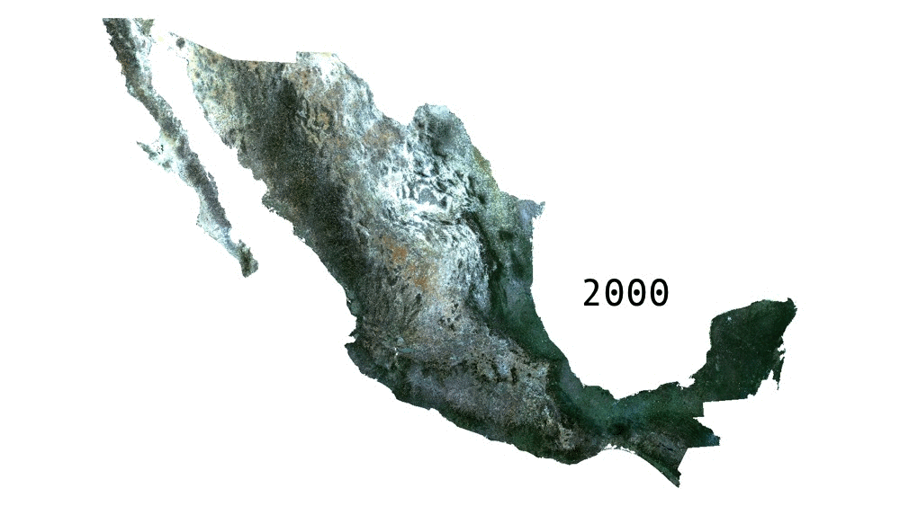
We [Mexico] have come a long way in improving our knowledge and use of Earth Observations within our geospatial information production at local, regional and national levels.
Notes:
Thanks to the collaboration with GEO and Geoscience Australia, we have come a long way in improving our knowledge and use of Earth Observations within our geospatial information production at local, regional and national levels.
And, through remaining open and always sharing our progress, we hope to contribute back to the global community to understand the critical role that Earth Observations data play in improving the lives of millions.

Slide 6
The GEO Community, its people, are GEO’s greatest asset.
Notes:
Apart from us, nations have also started to understand the critical role EO data will play in driving economic growth in a global economy that is more connected, dynamic and exposed to our changing planet. Our environmental and societal challenges are ever-growing and urgent.
In this regard, the GEO community must rise up to the opportunity to keep and increase the pace in support of cooperative, evidence-based decisions, and in offering solutions to better understand a rapidly-changing world, and achieve its peoples’ goals and aspirations in pursuit of sustainable development.
Behind all progress demonstrated in the activities of the GEO Work Programme – both incremental and great – stand bright and talented individuals with a commitment to advancing the vision of GEO
The GEO Community, its people, are GEO’s greatest asset. The work and mission continue to resonate with a large audience worldwide.

Slide 7
Notes:
https://www.youtube.com/watch?v=-YSk3-RUZis&feature=youtu.be
As you have seen, GEO is working in all corners of the world to ensure that EO delivers impact.
In addition to the work of the GEO flagships and regional GEOs, we have seen the integration of Earth observations into several of the SDG indicators.
We have witnessed closer collaboration and cooperation between AmeriGEO and the United Nations Council of Experts on Global Geospatial Information Management (UN-GGIM) in the Americas.
I am also very proud of the progress around the open data cube with Australia, Colombia, USA and GEO Secretariat, and others.
In the past four years we have seen how investments made in Earth observations have multiplier effects for economies and on lives.

Slide 8
GEO Week 2019 Ministerial Summit
Add text here
Notes:
That great video clearly showed some of the fantastic impacts Earth observations have made since the last Ministerial Summit was held in Mexico in 2015
The theme of the Summit is focused on scaling up investments in Earth observations and driving sustainable growth across economies.
Discussions throughout the day will emphasize the critical role EO data plays in a global economy that is more connected, dynamic and exposed to our changing planet.
Yesterday, in fact, a report was released on the Economic impact of Earth Observations to APEC Economies which highlighted that just for those economies, the current value of Earth observations was $370 Billion and was expected to rise to $1.45 Trillion dollars over the next ten years. Earth observations are therefore a critical enabler to our sustainable economic growth.
I would like to highlight a couple of extra examples where GEO is making a global impact.

Slide 9
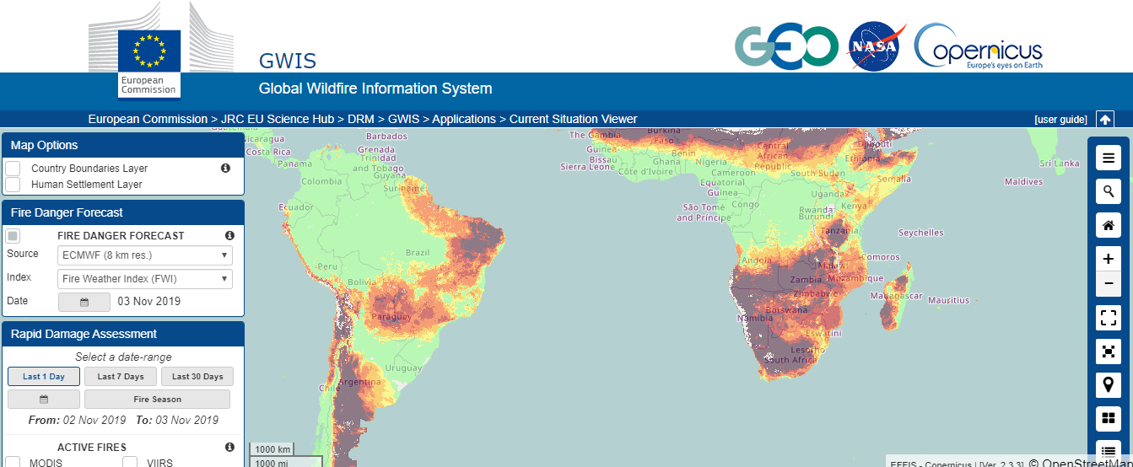
Investments delivering impact
Notes:
The Global Wildfire Information System is a joint initiative of the GEO, NASA and the Copernicus Emergency Management Services Work Programmes.
GWIS brings existing information sources together at regional and national levels to provide a comprehensive view in the current situation viewer.
An online platform that provides real time evaluation of fires and their effects at the global level.
This information is key for emergency response and informing public health risks related to fire emissions.

Slide 10
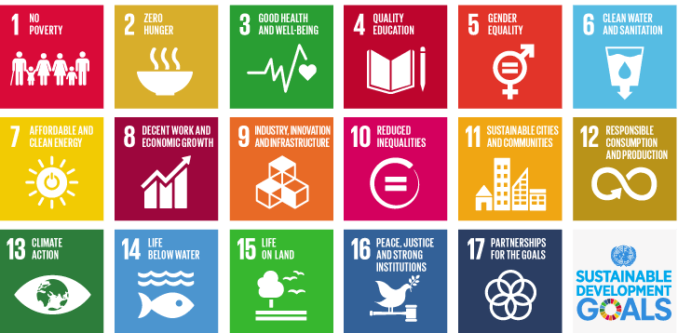
Investments delivering impact
Notes:
The Earth Observations for the Sustainable Develoment Goals (EO4SDG) is integrating Earth observations in national SDG monitoring, reporting and implementation processes.
For example on SDG 6 Clean Water they are developing approaches for SDG indicator 6.6.1: change in the extent of water-related ecosystems over time.
EO4SDG, AquaWatch and GEO Wetlands supported UN Environment and other stakeholders to explore the use of Earth observation data and tools for national monitoring and reporting. As a result of these activities, a new monitoring methodology was developed.

Slide 11
Investments delivering impact
Notes:
I would also like to highlight the work being done by teams across Africa and Australia to build Digital Earth Africa.
This initiative is poised to deliver economic benefits across the African continent through integrated approaches and investments.
Launched at the AfriGEO Symposium in August 2019, Digital Earth Africa is a continental-wide platform that democratizes the capacity of researchers to process and analyze satellite data.
In an era of Big Data and Cloud Computing, open data cube technologies are allowing researchers to more effectively use Earth observations data in their communities.
By concentrating investments from governments using open EO data, it is bringing down the cost to use EO, making it more accessible to diverse users.
We count on the continued support of governments to further advance the impact of open data cubes.

Slide 12
Setting the stage for the Canberra Ministerial Summit
Notes:
Consider this our call to all countries:
We are asking you to invest in Earth observations to manage economies, to improve communities and to protect ecosystems.
We hope that the outcomes of today’s discussions lead to the successful adoption of the Canberra Declaration that can guide GEO over the next four years.
The packed agendas for the Plenary and the Ministerial illustrate the great many ways that EO is delivering impact, most notably on sustainable development, climate action and disaster risk reduction.
While these topics cover a wide scope, there is much more we can do.
But for GEO to continue, we need your continued support.
So lets use this opportunity to guide the future of GEO and to achieve much more over the next four years.
Thank you!

Slide 13
It’s not over yet…
Port Elizabeth, South Africa
2-6 November, 2020

